Slide 1

CONSTRUCTION ROBOTS
A LASTING SOLUTION TO INFRASTRUCTURAL DEVELOPMENT.
BY
IYESOMI MAUREEN IMOMOH

Slide 2

AIMS
Maslow's hierarchy of needs:
To show how construction robots can be used to solve infrastructural problems, focusing on the most basic infrastructural and physiological need.
To show the technique by which construction projects can be automated from start to finish.
To show the unlimited possibilities this technique using construction robots can provide in infrastructural development and in the construction industry as a whole.

Slide 3
First, a general overview of robots
Coined by Karel Capek in 1920 to describe machines that resemble humans in his play called Rossums Universal Robots.
Robots today, are machines with artificial intelligence that are instructed to perform any task, mostly the 3ms and 3d tasks.
Menial, monotonous, meticulous, dangerous, difficult and dirty tasks.
Robots don’t have to look human , the design of a robot is determined primarily by its intended function.

Slide 4
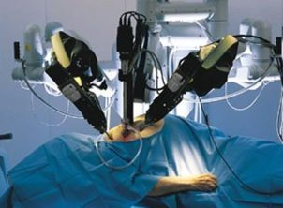
A surgical robot performing surgery on a patient … a task that must be performed meticulously.

Slide 5
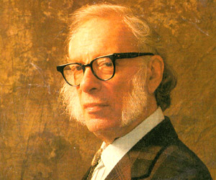
ISAAC ASIMOV- THE FATHER OF ROBOTICS
(Science Fiction Writer)
1941- Used the word "robotics" for the first time to describe the technology of robots
Created the "Three Laws of Robotics”:
A robot may not injure a human, through action or inaction.
A robot must obey the orders by human beings except where such orders conflict the First Law.
A robot must protect its own existence except such protection conflicts the First or Second Law.

Slide 6
Video of Humanoid robot Asimo!!!

Slide 7
As you have seen:
Despite their seeming intelligence, robots are still pretty much garbage in – garbage out.
Building completely intelligent robots with learning abilities and understanding like humans is the utopia of all AI and robotic scientists and engineers… me inclusive.

Slide 8

WHAT ARE CONSTRUCTION ROBOTS?
Typical construction machines inputted with intelligence

Slide 9
Some examples of existing construction robots…
Automated Excavator of University of Sydney
Rocco project brick assembly robot

Slide 10
SO WHY DO WE NEED CONSTRUCTION ROBOTS?
THE VISION...

Slide 11
LIVES AND INFRASTRUCTURAL DEVELOPMENT
High death toll in construction sites i.e. bridges, high rise buildings est..
While there is no duplicate for life, robot parts can be repaired or replaced.
Remember the 3ms and 3ds,
Dangerous tasks…Robots can do them.

Slide 12
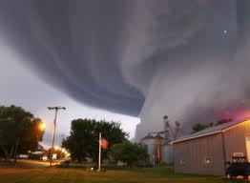
Climate change has forced us to take a closer look at how our structures are built…
More natural disasters are being predicted.
Better, more solid structures are needed
Durable structures…Robots can build them

Slide 13
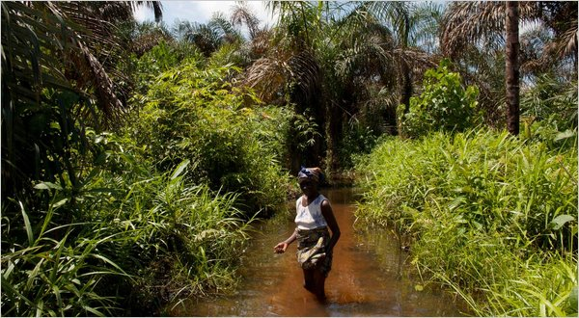

Swampy & topographically challenged terrains… robots can go there!
Niger Delta region:
Largest mangrove swamps in Africa
Stagnant swamp covers about 8600 sq/km
No basic infrastructure

Slide 14
ECONOMY AND INDUSTRY:
The construction industry is one of the oldest and represents the largest economic sectors, with it’s contribution to the GDP in industrialized countries of about 7-10%. In the US, this contribution rises to 12% and in the EU there are about 2.7 m enterprises (most of them Small and Medium Enterprises) involved in the business.

Slide 15
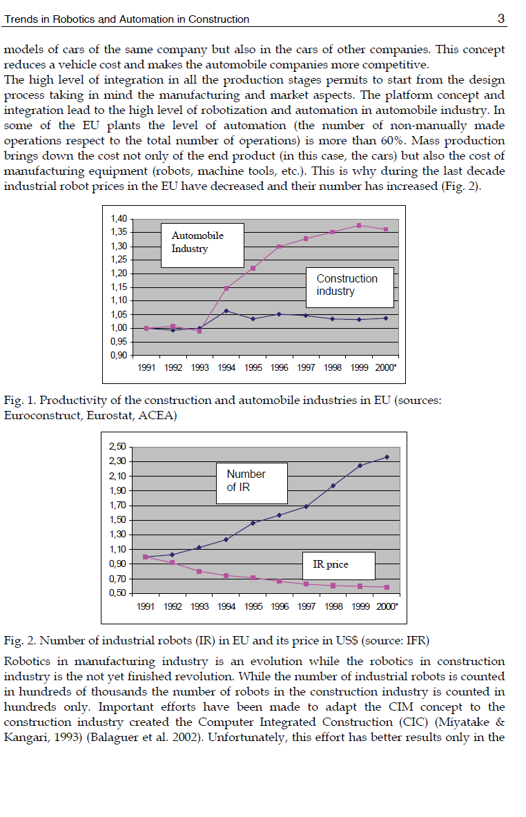
Astronomical Increase in Productivity … Robots can aid that.
Level of automation in the construction industry vs. automobile industry
Automation(robotics) in the automobile industry has been largely responsible for the colossal success, sophistication and productivity recorded in the industry.

Slide 16
So why isn’t there more automation in the construction industry?
The unstructured, dynamic nature of the construction site, the hazards and difficulties presented by weather and sometimes the shear scale of activity makes it almost impossible to achieve greater automation.

Slide 17
Is there a solution?
Is there a solution???

Slide 18
Simple idea!!!
Focus on one kind of construction project first.
Break down every aspect of that construction project into process algorithms.
Convert algorithm into code to be inputted into robots that will carry out each aspect sequentially.
With the success of that, move on to more complex structural types applying same principle.

Slide 19

But what kind of structure do we start with?
Most required kind of structure that benefits the most number of people.
… HOMES!!!

Slide 20


Well, houses are different,
There are 2 storey, sky scrapers, condos, flats est…
The kind of house we want, is one that will be:
The easiest to build,
Most affordable
Least material requiring,
Durable,
Compact,
Portable, and
Solid…
Wait for it…

Slide 21

The bungalow!
With only one storey , bungalows are
Easy to build
Economical
Effective
Safe

Slide 22

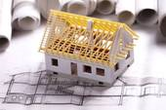
Let’s get technical.
In order to get robots to build a bungalow, we need technical help from human experts…

Slide 23
Expert based knowledge from the pros…
CEILING/POP E.K
ARTIST/INTERIOR FINISHING SPECIALIST
PLUMBING/
FITTING E.K
MECHANICAL ENGINEER
CONDUIT WIRING E.K
ELECTRICAL ENGINEER
TRUSSES AND ROOFING E.K
STRUCTURAL ENGINEER
LINTEL E.K
BRICKLAYING OR MASONRY E.K
BUILDER
GERMAN FLOOR E.K
FOUNDATION LAYING E.K
EARTH WORK EXPERT KNOWLEDGE
FOUNDATION ENGINEER
CONSTRUCTION PROJECT MANAGER
SYSTEMS ANALYST
PAINTING AND FINISHING E.K
PLASTERING E.B.K

Slide 24
Thus saith the pros…
14 basic steps(Algorithm)to building a simple bungalow in sequential order.
1. Dig
(Excavation)
4. Fill with sand
5. Pour concrete for the German floor
6. Assemble blocks to lintel level
3. Set foundation blocks to d.p.c level
2. Pour Concrete into foundation
7. Assemble lintel (pre - cast)
8. Assemble trusses
9. Set Roof
10. Electrical wiring/plumbing
11. Assemble Ceiling(pre – cast)
12.Set Windows/Doors
13.Plastering/POP work
14.Paint

Slide 25
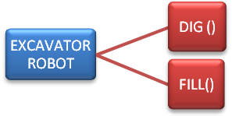
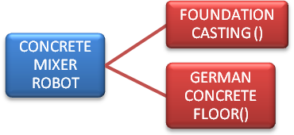


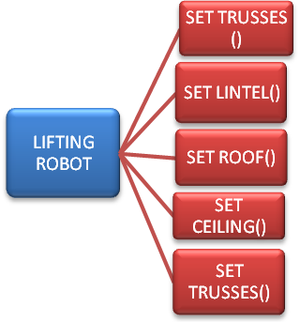


Similar processes are grouped along with their algorithms into the appropriate robot that will carry out the task.

Slide 26
A controller robot/computer queues the robots according to the algorithms’ sequential order and activates them when the process begins.
B.LAYING FOUNDATION BLOCKS()
EXCAVATOR DIG ()
C. MIXER FOUNDATION CASTING ()
EXCAVATOR FILL()
C.MIXER GERMAN FLOOR()
B.LAYING ROBOT MAIN BLOCKS()
LIFTING ROBOT SET LINTEL()
CONTROLLER COMPUTER

Slide 27
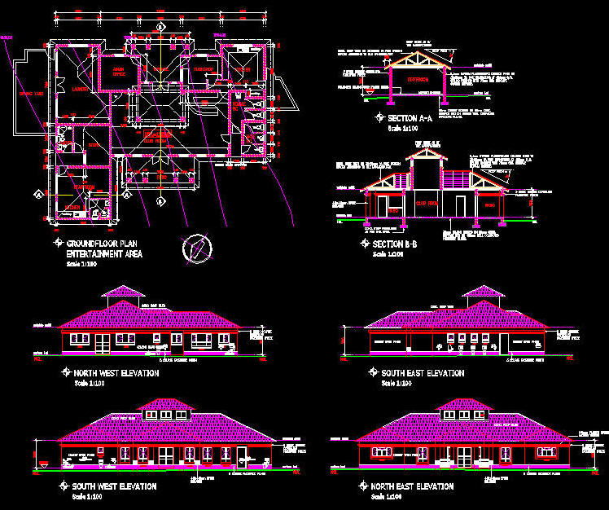
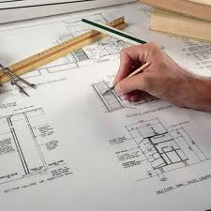
Where’s the design, Where’s the ARCHITECT?
CAM technology, allows machines to read CAD designs directly and execute with complete precision e.g. CNC software.
Used mainly in the manufacturing industry
Architectural design using the CAM technique, will be inputted into the controller computer which will in turn interpret to the robots on the queue.

Slide 28
And the best part is…
If robots can successfully build one bungalow, they can easily build 2, 30, 700, 1,000,000,…uncountable, by duplicating the designs and methods used in the first.
Remember the 3ms and 3ds, robots specialize in monotonous(repetitive) task

Slide 29


The most remarkable thing about this is that housing will continue to remain the most pressing infrastructural need…
From Lagos to warri, housing is a concern.
From the projects in America to the slums in the UK, housing is a concern.
So…

Slide 30

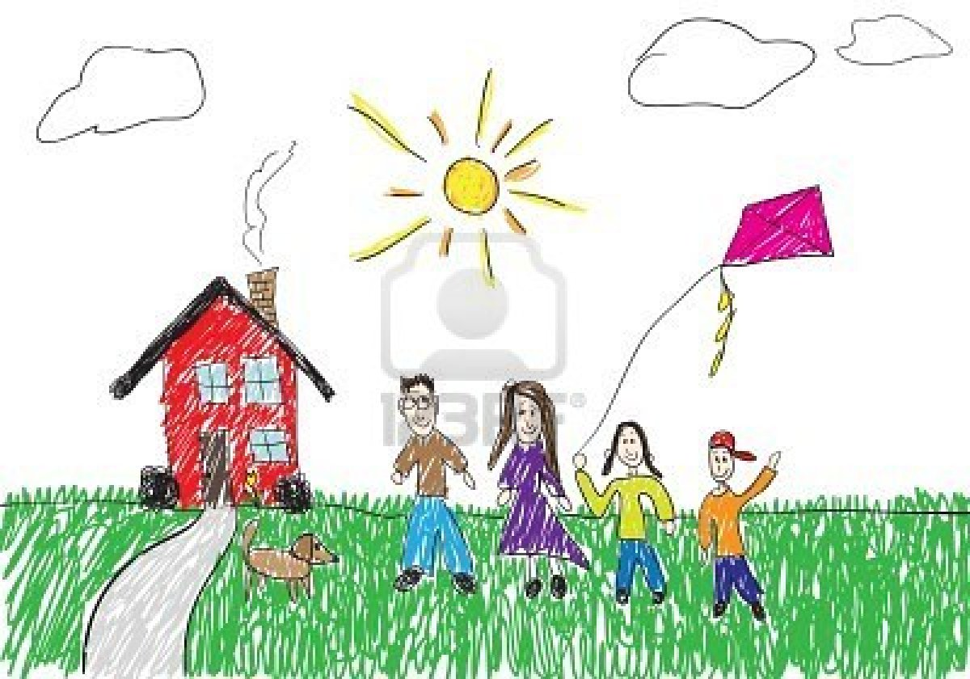
In partnership with government, we can put an end to the housing issue worldwide in a few short years.
Some people’s only hope for owning a home is the mansion prepared for them with Father Abraham in heaven!
Mass produced quality houses will make housing affordable which governments can sell at subsidized rates to their citizens.
Citizens own their homes through low cost housing schemes

Slide 31
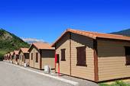
Topographically challenged areas.
A swampy terrain like the Niger Delta and others can be turned to a first class estate.
No more excuses for lack of infrastructure.

Slide 32
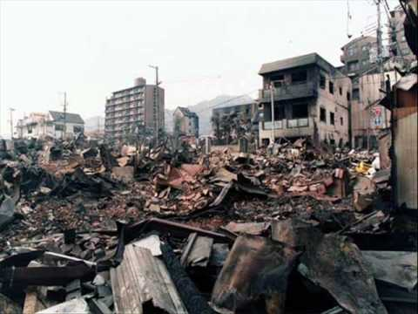

What they need…
In the past two decades, 141 million people have lost their homes through 3559 natural disaster ...
“I’ve lost everything”, is a common phrase that victims of natural disasters say when their homes are blown away.
Natural Disaster Victims
Restoring their homes in a short time will save them from lengthy post traumatic issues.

Slide 33
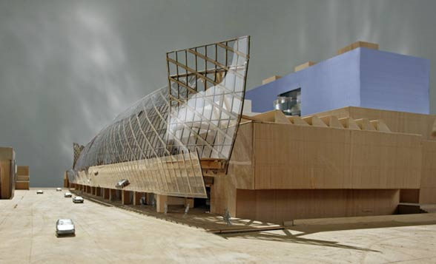


Freedom in esthetic and design
When construction robots successfully build simple structures , then more complex structures would soon follow like roads, bridges and other basic infrastructure

Slide 34

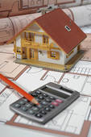

Speedy returns on Investment
The reduction of construction time would improve cost benefit analysis of construction project due to faster availability and return on investment of real estate

Slide 35
General Benefits of the System:
By automation, increased productivity could reduce high labor cost share of 40 or more percent.
Automated and robotized construction process lead to a continuous working time through the year.
Introduction of robotic technology would result in better working and health conditions, and advanced mechatronics know how and skills.
Definition of quality
Control and transparency of the quality

Slide 36
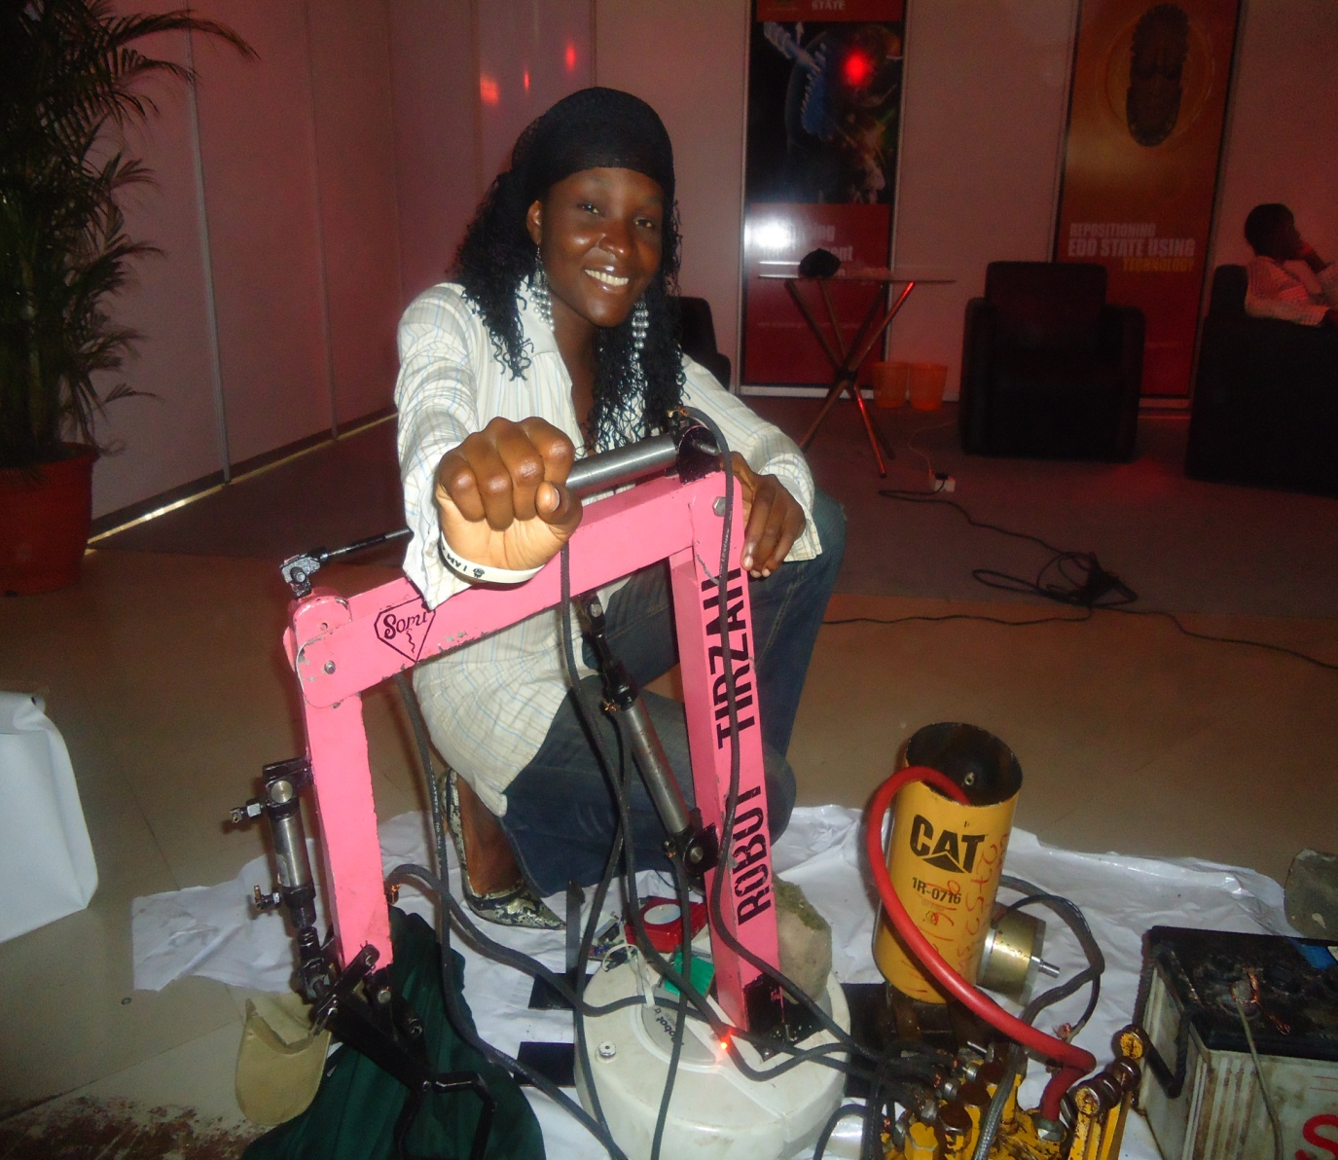
This is not just abstract…
Meet Robot Tirzah
She is a prototype for a hydraulic powered excavator robot I’m working on.
One in a series of robots to be used for the processes described above.

Slide 37
Hope you enjoyed it.
Thank you

Slide 38
Questions Pls…

Slide 39
THE END

